Slide 1
Public Health Accelerator Bids (PHAB) grant programme
A guide to project approaches

Slide 2
To change image:
Delete existing image and insert new by clicking on icon
or
Right-click, change picture
If new picture causes placeholder to resize or rotate
Click on ‘Reset’ under ‘Slides’ tab on Ribbon
To resize or reposition image within placeholder:
Picture Format> Crop
Resize using white circles at corners
Move by click+hold on grey area of image then drag to position
As part of your organisation’s application for a Public Health Accelerator Bid (PHAB) grant we have asked you to identify your project approach.
We have asked you which of the following best applies to your project
Population Health Management (PHM)
Place based public health
Partnerships that address wider determinates of health
Prioritising mental health and wellbeing
Proportionate Universalism
This guide can be used to help you identify your project approach (if you don’t already know it)
If you have any questions or need further advice please contact PHABApplications@activeessex.org

Slide 3
Population Health Management (PHM)
Population Health Management (PHM) is a way of working to help frontline teams understand current health and care needs and predict what local people will need in the future.
Only 20% of a person’s health outcomes are attributed to the ability to access good quality health care.
PHM is a partnership approach across the NHS and other public services including councils, the public, schools, the fire service, voluntary sector, housing associations, social services and the police. All have a role to play in addressing the issues that affect people’s health and wellbeing.
PHM uses historical and current data to understand what factors are driving poor outcomes in different population groups. Local health and care services can then design new proactive models of care which will improve health and wellbeing today as well in future years.
This means organisations can tailor better care and support for individuals, design more joined up and sustainable health and care services and make better use of public resources.

Slide 4
Place based Public Health
Place based working is a person-centred, bottom up approach used to meet the unique needs in one given location by working together to use the best available resources and collaborate to gain local knowledge and insight.
By working collaboratively with the people who live and work locally, it aims to build a picture of the system from a local perspective, taking an asset based approach that seeks to highlight the strengths, capacity and knowledge of all those involved.

Slide 5
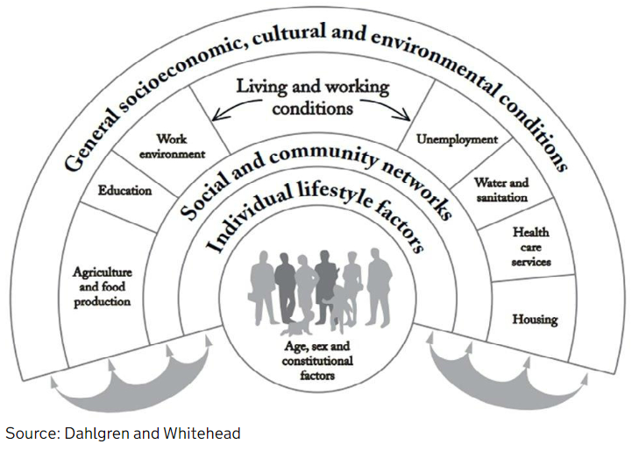
Partnerships that address the wider determinates of health
The wider determinates of health are also known as the social determinates, they are the social, economic and environmental factors which impact on people’s health.
Wider determinates have an importance influence on health inequalities the lower the socio-economic position, the worse the health. Research has shown that wider determinates can be more important than health care or lifestyle choices in influencing health.
For example, a family who live in a damp and mouldy home are likely to develop respiratory issues, regardless of whether or not they smoke.

Slide 6
Prioritising mental health and wellbeing
Mental health and mental illness has an impact on everyone – either directly or indirectly. People with more serious mental illness die 15 – 20 years earlier than the rest of the population and suicide is the leading cause of death for people between the ages of 10 and 34.
Our mental health influences our physical health as well as our capability to lead a healthy lifestyle and to manage and recover from physical health conditions.
People with physical health problems, especially long term conditions, are at increased risk of poor mental health – particularly depression and anxiety. Around 30% of people with any long term physical health condition also have a mental health problem. Poor mental health, in turn, exacerbates some long term conditions, such as chronic pain.
The World Health Organisation defines mental health as “a state of wellbeing in which the individual realises their abilities, can cope with the normal stresses of life, work productively and fruitfully, and is able to make a contribution to his or her community”

Slide 7
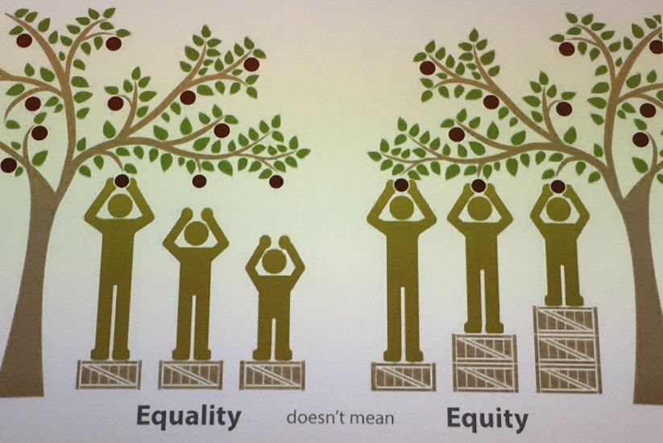
Proportionate universalism
Proportionate universalism is the resourcing and delivery of universal services at a scale and intensity proportionate to the degree to need. Services are therefore universally available, not only for the most disadvantaged, and are able to respond to the level of presenting need.
Proportionate universalism aims to improve the health of the whole population, across the social gradient, whilst simultaneously improving the health of the most disadvantaged fastest.
Planning for proportionate universalism requires an assessment of need and an understanding of the impact of social inequalities on health outcomes.

Slide 8
This information is issued by: Essex County Council
Contact us: PHABApplications@activeessex.org
Essex County Council County Hall, Chelmsford Essex, CM1 1QH
Essex_CC
facebook.com/essexcountycouncil
The information contained in this document can be translated, and/or made available in alternative formats, on request.
Published 2023

