Slide 1
Effective Support for Children & Families in Essex Needs and Indicators
Notes:
Slide Number: 1
Learning Outcomes:
The Learner understands both the levels of need and the range of indicators that can be used to identify the appropriate level of need
The Learner is able to apply that understanding to their work with children, young people and families

Slide 2
Effective Support for Children & Families in Essex (Guidance)
This guidance is for everyone who works with children and young people and their families in Essex.
“In Essex we all believe that every child should have the opportunity to reach their full potential and that children are best supported to grow and achieve within their own families.
By working together, we will develop flexible services which are responsive to children’s and families’ needs and provide the right level of intervention at the right time.”
Notes:
Slide Number : 2 & 3
Title: Effective Support for Children and their Families in Essex Guidance
Key Messages
Important for the Facilitator to emphasise that this is guidance that has been agreed and signed up to by partners and is endorsed through the Essex Safeguarding Children’s Board (ESCB). It also reflects the Southend Essex Thurrock (SET) Procedures and Early Help offer
Facilitator Notes
The guidance approach is to.....solve problems and find solutions
at an early stage;
at the point that needs become more apparent;
whilst recognising that there may be times when the needs of the family are such that intensive or specialist statutory intervention is required
Resources Required None specific

Slide 3
Effective Support for Children & Families in Essex
It is about the way we can all work together, share information and put the child and their family at the centre, providing effective support to help them solve problems and find solutions at an early stage to prevent problems escalating
There may be times when the needs of the family are such that intensive or specialist statutory intervention is required
The aim is always to both build resilience in children and families and the capacity to overcome their own difficulties, for the remainder of their lives.
There are 4 levels Universal, Additional, Intensive and Specialist.
Notes:
Slide Number: 3
Title: Effective Support for Children and their Families in Essex Guidance
(refer to notes under slide 2)

Slide 4
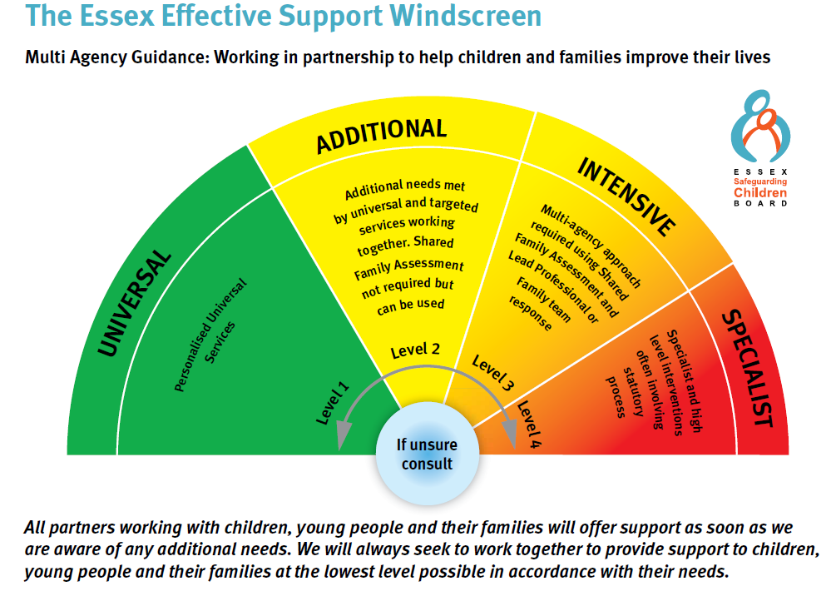
Notes:
Slide Number : 4
Title: Effective Support Windscreen
Key Message(s)
The Facilitator should highlight ‘ If Unsure Consult’
It should also be made clear that the model should not just be viewed as moving from green to red but as importantly how practitioners work together to de-escalate Red to Green
Facilitator Notes -
Use the appropriate descriptions in the Effective Support for Children & Families in Essex Guidance document, latest version available from ESCB website, if you wish to expand the description of each of the levels.
Resources Required- Effective Support for Children & Families in Essex Guidance document

Slide 5
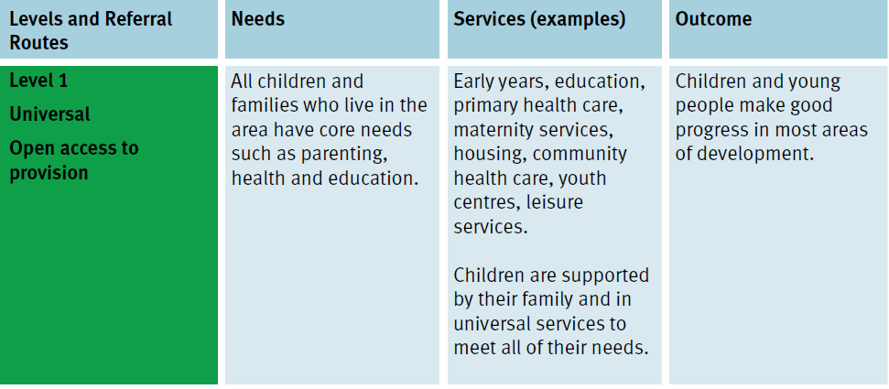
Effective Support Guidance & Support Windscreen – Level 1 Universal
Notes:
Slide Number : 5 & 6 contain the same information but displayed differently. The Facilitator can prefer which one to use
Title: Windscreen - Level 1 – Universal
Key Messages
Depending upon audience the Facilitator may wish to highlight parts of the information
Facilitator Notes
The wording in the following slides are excerpts from the Guidance document.
Each attendee should have their own copy.
If it has been circulated beforehand the following slides may be skipped over quickly.
If not, depending on knowledge level of attendees, the Facilitator may wish to highlight parts of the information.
Resources Required - Copies of Guidance document or relevant extracts

Slide 6
Effective Support Guidance & Support Windscreen – Level 1 Universal
Level & Referral Routes - Universal open access to provision
Needs All children and families who live in the area have core needs such as parenting, health and education.
Services (examples) Early years, education, primary health care, maternity services, housing, community health care, youth centres, leisure services. Children are supported by their family and in universal services to meet all of their needs
Outcomes Children and young people make good progress in most areas of development
Notes:
Slide Number : 6 (Slide Number : 5 & 6 contain the same information but displayed differently. The Facilitator can prefer which one to use)
Title: Windscreen -Level 1 Universal
Key Messages
Depending upon audience the Facilitator may wish to highlight parts of the information
Facilitator Notes
The wording in the following slides are excerpts from the Guidance document.
Each attendee should have their own copy.
If it has been circulated beforehand the following slides may be skipped over quickly.
If not, depending on knowledge level of attendees, the Facilitator may wish to highlight parts of the information.
Resources Required - Copies of Guidance document or relevant extracts

Slide 7
Effective Support Guidance & Support Windscreen – Level 1 Universal
Indicator:
Children and young people who make good overall progress in most areas of development
Receive appropriate universal services, such as health care and education.
They may also use leisure and play facilities, housing or voluntary sector services.
Notes:
Slide Number : 7
Title: Title: Windscreen - Level 1 Universal
Key Messages
Depending upon audience the Facilitator may wish to highlight parts of the information
Facilitator Notes
The wording in the following slides are excerpts from the Guidance document.
Each attendee should have their own copy.
If it has been circulated beforehand the following slides may be skipped over quickly.
If not, depending on knowledge level of attendees, the Facilitator may wish to highlight parts of the information.
Resources Required - Copies of Guidance document or relevant extracts

Slide 8
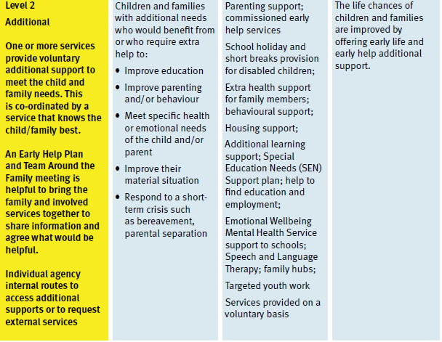
Effective Support Guidance & Support Windscreen – Level 2 Additional
Notes:
Slide Number(s) : 8 & 9 contain the same information but displayed differently. The Facilitator can prefer which one to use
Title: Windscreen - level 2 Additional
Key Messages
Depending upon audience the Facilitator may wish to highlight parts of the information
Facilitator Notes
The wording in the following slides are excerpts from the Guidance document.
Each attendee should have their own copy.
If it has been circulated beforehand the following slides may be skipped over quickly.
If not, depending on knowledge level of attendees, the Facilitator may wish to highlight parts of the information.
Resources Required - Copies of Guidance document or relevant extracts

Slide 9
Level 2 Additional
Level & Referral Routes -Additional One or more services provide voluntary additional support to meet the child and family needs. This is co-ordinated by a service that knows the child/family best. An Early Help Plan and Team Around the Family meeting is helpful to bring the family and involved services together to share information and agree what would be helpful. Individual agency internal routes to access additional supports or to request external services
Needs Children and families with additional needs who would benefit from or who require extra help to: Improve education; improve parenting and/or behaviour; meet specific health or emotional needs of the child and/or parent; improve their material situation; respond to a short term crisis such as bereavement; parental separation
Services (examples) Parenting support; commissioned early help services; school holiday and short breaks provision for disabled children; extra health support for family members; behavioural support; housing support; additional learning support; Special Education Needs (SEN) Support plan; help to find education and employment; emotional Wellbeing Mental Health Service support to schools; speech and Language therapy; family hubs; targeted youth work; Services provided on a voluntary basis
Outcomes The life chances of children and families are improved by offering early life and early help additional support.
Notes:
Slide Number: 9 (Slides 8 & 9 contain the same information but displayed differently. The Facilitator can prefer which one to use)
Title: Windscreen - level 2 Additional
Key Messages
Depending upon audience the Facilitator may wish to highlight parts of the information
Facilitator Notes
The wording in the following slides are excerpts from the Guidance document.
Each attendee should have their own copy.
If it has been circulated beforehand the following slides may be skipped over quickly.
If not, depending on knowledge level of attendees, the Facilitator may wish to highlight parts of the information.
Resources Required - Copies of Guidance document or relevant extracts

Slide 10
Effective Support Guidance & Support Windscreen – Level 2 Additional
Indicators :
Children and young people whose needs require some extra support.
A single universal or targeted service or two services are likely to be involved; these services should work together.
A Team Around the Family meeting to share information and agree an Early Help
Plan to support the child and family is helpful.
No need for specialist services.
Notes:
Slide Number: 10
Title: Title: Windscreen - level 2 Additional
Key Messages
Depending upon audience the Facilitator may wish to highlight parts of the information
Facilitator Notes
The wording in the following slides are excerpts from the Guidance document.
Each attendee should have their own copy.
If it has been circulated beforehand the following slides may be skipped over quickly.
If not, depending on knowledge level of attendees, the Facilitator may wish to highlight parts of the information.
Resources Required - Copies of Guidance document or relevant extracts

Slide 11
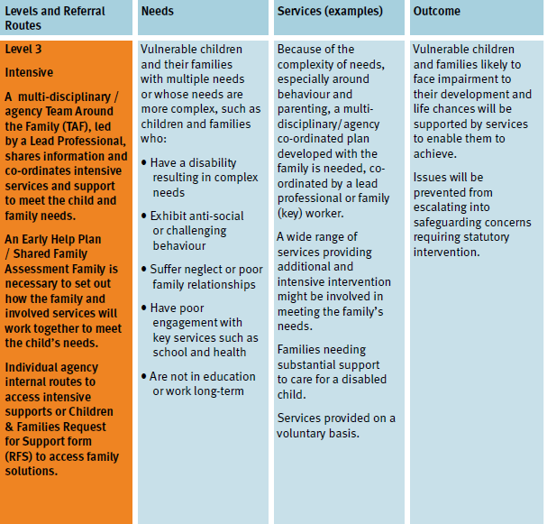
Effective Support Guidance & Support Windscreen – Level 3 Intensive
Notes:
Slide Number: 10 (Slide Numbers: 9 & 10 contain the same information as 11 but displayed differently. The Facilitator can prefer which one to use
Title: Effective Support Guidance & support Windscreen - levels and indicators
Key Messages
Depending upon audience the Facilitator may wish to highlight parts of the information
Facilitator Notes
The wording in the following slides are excerpts from the Guidance document.
Each attendee should have their own copy.
If it has been circulated beforehand the following slides may be skipped over quickly.
If not, depending on knowledge level of attendees, the Facilitator may wish to highlight parts of the information.
Resources Required - Copies of Guidance document or relevant extracts

Slide 12
Level 3 Intensive
Level & Referral Routes -Level 3 Intensive A multi-disciplinary / agency Team Around the Family (TAF), led by a Lead Practitioner, shares information and co-ordinates intensive services and support to meet the child and family needs. An Early Help Plan / Shared Family Assessment Family is necessary to set out how the family and involved services will work together to meet the child’s needs. Individual agency internal routes to access intensive supports or Children & Families Request for Support form (RFS) to access Family Solutions.
Needs Vulnerable children and their families with multiple needs or whose needs are more complex, such as children and families who: have a disability; resulting in complex needs; Exhibit anti-social or challenging behaviour; suffer neglect or poor family relationships; have poor engagement with key services such as school and health; are not in education or work long-term
Services (examples) Because of the complexity of needs, especially around behaviour and parenting, a multidisciplinary/ agency co-ordinated plan developed with the family is needed, coordinated by a Lead Practitioner or family (key) worker. A wide range of services providing additional and intensive intervention might be involved in meeting the family’s needs. Families needing substantial support to care for a disabled child. Services provided on a voluntary basis.
Outcomes Vulnerable children and families likely to face impairment to their development and life chances will be supported by services to enable them to achieve. Issues will be prevented from escalating into safeguarding concerns requiring statutory intervention.
Notes:
Slide Number(s) : 12 (Slide 11 & 12 contain the same information but displayed differently. The Facilitator can prefer which one to use )
Title: Windscreen - level 3 Intensive
Key Messages
Depending upon audience the Facilitator may wish to highlight parts of the information
Facilitator Notes
The wording in the following slides are excerpts from the Guidance document.
Each attendee should have their own copy.
If it has been circulated beforehand the following slides may be skipped over quickly.
If not, depending on knowledge level of attendees, the Facilitator may wish to highlight parts of the information.
Resources Required - Copies of Guidance document or relevant extracts

Slide 13
Effective Support Guidance & Support Windscreen – Level 3 Intensive
Indicators:
A number of indicators would need to be present with more than one service involved
Team Around the Family, Early Help Plan/Shared Family Assessment approach required.
Family Solutions can support at this level
Notes:
Slide Number: 13
Title: Windscreen - level 3 Intensive
Key Messages
Depending upon audience the Facilitator may wish to highlight parts of the information
Facilitator Notes
The wording in the following slides are excerpts from the Guidance document.
Each attendee should have their own copy.
If it has been circulated beforehand the following slides may be skipped over quickly.
If not, depending on knowledge level of attendees, the Facilitator may wish to highlight parts of the information.
Resources Required - Copies of Guidance document or relevant extracts

Slide 14
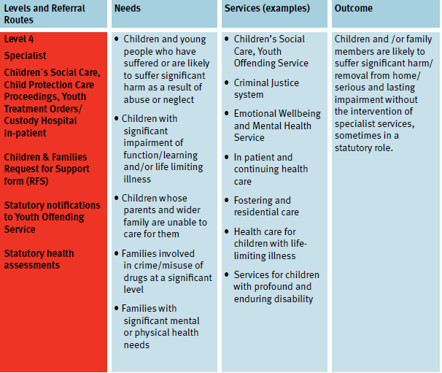
Effective Support Guidance & Support Windscreen – Level 4 Specialist
Notes:
Slide Number: 14 (Slide 14 & 15 contain the same information but displayed differently. The Facilitator can prefer which one to use)
Title: Windscreen - level 4 Specialist
Key Messages
Depending upon audience the Facilitator may wish to highlight parts of the information
Facilitator Notes
The wording in the following slides are excerpts from the Guidance document.
Each attendee should have their own copy.
If it has been circulated beforehand the following slides may be skipped over quickly.
If not, depending on knowledge level of attendees, the Facilitator may wish to highlight parts of the information.
Resources Required - Copies of Guidance document or relevant extracts

Slide 15
Level 4 - Specialist
Level & Referral Routes - Level 4 Specialist Children`s Social Care, Child Protection Care Proceedings, Youth Treatment Orders/ Custody Hospital in- patient; Children & Families Request for Support (RFS); Statutory notifications to Youth Offending Service; Statutory health assessments
Needs Children and young people who have suffered or are likely to suffer significant harm as a result of abuse or neglect; Children with significant impairment of function/learning and/or life limiting illness; Children whose parents and wider family are unable to care for them; Families involved in crime/misuse of drugs at a significant level; Families with significant mental or physical health needs
Services (examples) Children’s Social Care; Youth Offending Service; Criminal Justice system; Emotional Wellbeing and Mental Health Service; In patient and continuing health care; Fostering and residential care ; Health care for children with life limiting illness; Services for children with profound and enduring disability
Outcomes Children and /or family members are likely to suffer significant harm/ removal from home/ serious and lasting impairment without the intervention of specialist services, sometimes in a statutory role.
Notes:
Slide Number: 15 (Slide 14 & 15 contain the same information but displayed differently. The Facilitator can prefer which one to use )
Title: Windscreen - level 4 Specialist
Key Messages
Depending upon audience the Facilitator may wish to highlight parts of the information
Facilitator Notes
The wording in the following slides are excerpts from the Guidance document.
Each attendee should have their own copy.
If it has been circulated beforehand the following slides may be skipped over quickly.
If not, depending on knowledge level of attendees, the Facilitator may wish to highlight parts of the information.
Resources Required - Copies of Guidance document or relevant extracts

Slide 16
Effective Support Guidance & Support Windscreen – Level 4 Specialist
Indicator(s):
Children and young people whose needs are complex and enduring and cross many domains.
More than one service is normally involved, with a co-ordinated multi-agency approach and a Lead Practitioner, commonly in a non-statutory role.
At times statutory intervention may be required
Notes:
Slide Number: 16
Title: Windscreen - level 4 Specialist
Key Messages
Depending upon audience the Facilitator may wish to highlight parts of the information
Facilitator Notes
The wording in the following slides are excerpts from the Guidance document.
Each attendee should have their own copy.
If it has been circulated beforehand the following slides may be skipped over quickly.
If not, depending on knowledge level of attendees, the Facilitator may wish to highlight parts of the information.
Resources Required - Copies of Guidance document or relevant extracts

Slide 17
Activity
Using the level descriptors from the Effective Support Document, look at the case study and decide at what level they are best placed.
Discuss in your groups:
What discussions do you need to have and with who?
What level of service do you think the family need
Why you think they are at this level?
Notes:
Slide Number : 16 Activity
NB- This could be done before the slides as a way of checking out audience understanding/knowledge/skills and then using the slides to address any misconceptions or reinforce key points. Alternatively it can be undertaken at the end of session to assess learning
Key Message(s) (The conversation will need to be carefully managed)
It will need to be acknowledged that not all the information has been provided and opinions will be based to an extent on experience and gut feeling.
As this is a training environment, the purpose is to familiarise the attendees with the guidance. Assessing the risk is part of that understanding but it is not essential that opinions are seen as correct or one team is right and the other wrong.
Remind attendees that they should discuss support / safeguarding needs with their designated safeguarding lead or use the Consultation Line prior to submitting a Request for Support.
Facilitator Notes (Activity 3)
The aim of this exercise is to build a picture (the case studies are in three parts)
The Facilitator can decide how to use the case studies e.g. each table may have a different case studies or all have the same.
The Facilitator should ideally use their own agency case studies.
After part one has been shared, the Facilitator should take a temperature check as to what each groups view is. At this stage the information may suggest a specific level e.g. level 2.
As subsequent information is discussed and groups feedback, opinions may change and it is important that the Facilitator draw out of attendees why their opinion has changed.
The whole discussion will take minimum of 15 mins.
Finally each group should feedback what their eventual assessment is. (10 minutes).
Depending on the case study there may be particular issues that the Facilitator would wish to highlight
Resources Required
Case studies (split into parts)
Each group should have a copy the extracts from the Effective Support Document to refer to.

